Slide 1
CUSTOMER SUPPORT CHATBOT WITH ML
PIP2001 Capstone Project
Review-1
Batch Number: CST-G17
Under the Supervision of,
Dr. Chandrasekar Vadivelraju
Professor
School of Computer Science and Engineering
Presidency University
Roll Number | Student Name
20211CST0117 20211CST0121 20211CST0100 20211CST0118 | Chandana R Darshan S Ashwini Bhardhi Shreyas R N
Name of the Program: PIP 2001 (CAPSTONE PROJECT)
Name of the HoD: Dr Sira Banu
Name of the Program Project Coordinator: Dr Manjula H M
Name of the School Project Coordinators: Dr. Sampath A K / Dr. Abdul Khadar A / Mr. Md Ziaur Rahman

Slide 2
Introduction
A customer support system that is easily and readily available is essential for any customer oriented business. In general, it can be observed that people want their problems to be addressed quickly and efficiently. We would like to build an online natural language chatbot platform which would address queries put forth to it in natural language. By extracting the issue at hand from a particular query, the platform would then find the solution in a pre-existing database. It would then guide the customer, step by step, on how to solve his problem in the most effective way possible. A customer would be able to easily use the support chatbot rather than having to directly talk to a customer care executive. This would largely reduce the amount of time a customer would have to wait in order for her concerns and grievances to be addressed. This would also reduce the load and traffic on the physical call centres. With the help of the natural language chatbot, a customer would not be required to have prior knowledge of where and how he needs to address her complaint

Slide 3
Literature Review
The concept of chatbots dates back to 1950 when Alan Turing posed the question, “Can machines think?” The foremost duplications aimed to pass the Turing test by mimicking mortal discussion as nearly as possible. In 1966, the first known chatbot, ELIZA, developed at MIT, was designed to act as a psychotherapist, employing pattern matching and template-based responses to conduct question-based interactions. This paved the way for advancements like PARRY, created by Kenneth Colby, which simulated a paranoid patient by incorporating a distinct personality. Another significant development was ALICE, introduced by Richard Wallace in 1995, which utilized pattern-matching techniques to generate example sentences from output templates, ensuring appropriate responses. Renewed interest in artificial intelligence (AI) and advances in machine learning (ML) have significantly expanded the application of chatbots across various fields. For instance, Smarter Child, developed by Active Buddy, Inc., gained widespread use through messenger apps. This was followed by the advent of voice-activated web-based assistants such as Apple Siri, Amazon Alexa, Google Assistant, and Microsoft Cortana. In the realm of healthcare, chatbots have become increasingly vital, particularly for diabetes management.

Slide 4
Existing method Drawback
Limited Understanding of Complex Queries
Difficulty with Context Retention
Inability to Handle Emotional or Sensitive Issues
Dependency on High-Quality Training Data
Challenges with Multilingual Support
High Maintenance and Continuous Improvement Needs
Low Accuracy in Detecting User Intent
Limited Ability to Escalate Effectively to Human Agents
Lack of Personalization

Slide 5
Proposed Method
Hybrid NLP Pipeline for Enhanced Understanding
Context-Aware, Long-Short-Term Memory (LSTM) Mechanisms
Sentiment and Emotion Detection for Adaptive Responses
Personalized User Experience through Integrations
Human-AI Collaboration for Complex Queries
Advanced Security and Privacy Mechanisms
Multilingual and Multi-Platform Capabilities

Slide 6
Methodology/Modules
Natural Language Processing (NLP) Pipeline
Machine Learning Models
Training Data
Development Frameworks and Tools
User Interface (UI) and Experience
Monitoring and Analytics

Slide 7
Objectives
Provide Instant, 24/7 Support
Automate Responses to Frequent Queries
Improve Response Consistency
Enhance Customer Engagement and Satisfaction
Collect Customer Data and Feedback
Support Upselling and Cross-Selling Opportunities
Reduce Operational Costs
Improve Agent Efficiency and Focus
Adapt and Learn Over Time

Slide 8
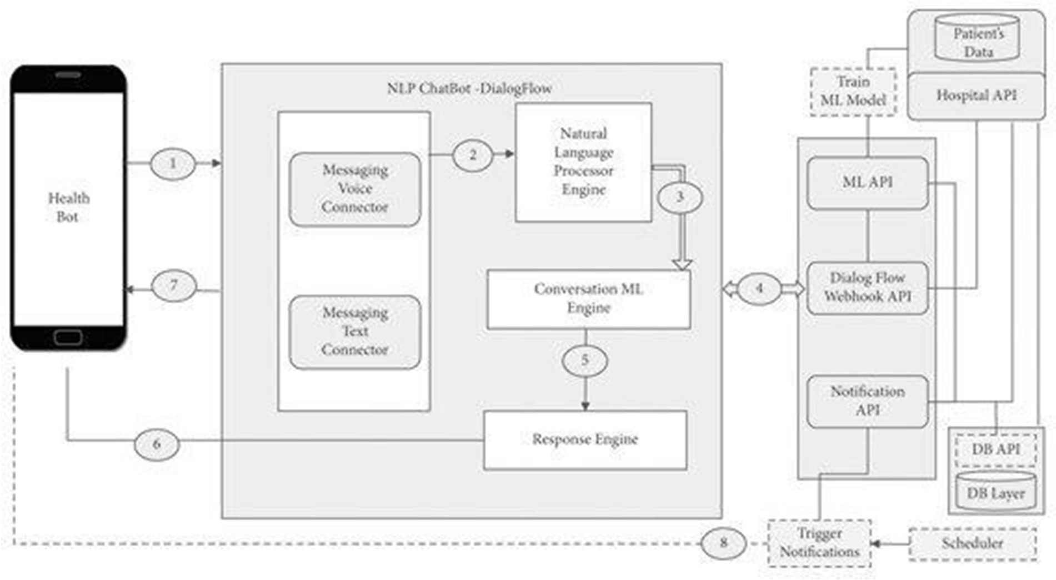
Architecture

Slide 9
Hardware/software components
Frontend: Flask, JavaScript, HTML, CSS, Bootstrap, jQuery, Web Speech API, Google Cloud text to speech, botUI.
Backend: PyTorch, Natural Language Toolkit, SpaCy, Rasa NLU, Python, MongoDB, Translate API

Slide 10



Timeline of Project
Sep-2024
Oct-2024
Nov-2024
Dec-2024
Jan-2025
Feb-2025
Phase 01
15-Sep-2024 To 24-Oct-2024
Phase 02
25-Oct-2024 To 28-Nov-2024
Phase 03
29-Dec-2024 To 15–Dec-2024
Project Planning and Initial Setup
Core Development
Deployment and User Acceptance Testing

Slide 11
Expected Outcomes
Improved Customer Satisfaction
Higher Efficiency and Reduced Workload for Support Teams
Consistent and Accurate Information Delivery
Cost Savings and Increased Scalability
Enhanced Data Collection and Insights
Increased Brand Loyalty and Customer Retention
Continuous Improvement with Learning Capabilities

Slide 12
Conclusion
In conclusion, developing a customer support chatbot using machine learning offers substantial benefits for both businesses and customers. By leveraging ML techniques, chatbots can provide instant, accurate, and personalized responses, creating a streamlined support experience that is available 24/7. This enhances customer satisfaction and builds brand loyalty by delivering consistent, high-quality support across various channels.

Slide 13
Github Link
The Github link provided should have public access permission.
Github Link

Slide 14
References
https://www.researchgate.net/publication/383686860_College_Chatbot_Using_RASA
https://www.ijraset.com/best-journal/health-care-chatbot-873
https://doi.org/10.22214/ijraset.2024.57932
https://www.ijraset.com/best-journal/nora-healthcare-voice-based-chatbot

Slide 15
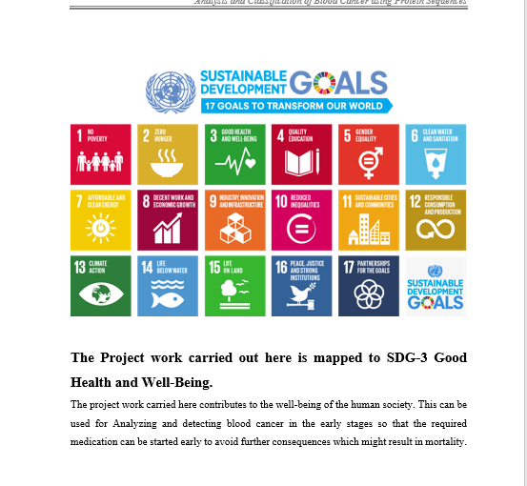
Project work mapping with SDG

Slide 16
Thank You

